Slide 1
The evolving services market
On demand services
FLEXIBLE HOSTING, MODULAR APPS
Transformational Outsourcing
NEW INDUSTRY FOCUS…CREATION OF BCS
e-business Services
E-COMMERCE, GLOBAL COLLABORATION, NEW BUSINESS APPS, MOBILE
Traditional Data Center
SERVER & SOFTWARE OPERATIONS, DISTRIBUTED SERVICES, CRITICAL BUSINESS APPS
1996
1998
2000
2002
2004
2006
Notes:
Services have changed over the years, adapting to market trends and needs...first with client server computing, then network computing, now with the Internet.
Doing business over the Internet calls for different services...not always traditional outsourcing
e-sourcing represents the next wave of IT services.
Hosting and utility computing are coming into play more and more...do it for me, but do it in a standard format so I can communicate/do business with others
With the Internet, outsourcing morphed and took on a new shape/form -- e-business services. And while this was happening, new technologies were developed and needed to be integrated into our strategy, such as pervasive computing, Linux, wireless
Meanwhile, technology continues to advance toward a more intelligent infrastructure - GRID computing, eLiza and autonomic computing
Technologies that are more intelligent, that can identify problems and "heal" themselves
Grid computing - extends computing capabilities to the Internet
Services are again moving and changing with the market needs.
e-sourcing represents the newest computing model and IBM Global Services is moving in that direction as well
Background on transformational outsourcing:
The most recent trend in IT services was called transformational outsourcing. It was a logical step forward in the e-business adoption.
With transformational outsourcing, companies embraced e-business throughout their organizations in order to transform their business processes.
Transformational outsourcing moved us (IBM) beyond simply taking over existing IT functions (traditional outsourcing), and into the area of helping customers build entirely new ways of operating.
Transformational outsourcing wasn't just another way to cut IT costs. It was about aligning IT resources for maximum business value.
Transformational outsourcing created a broader view of outsourcing because it takes into account both present and future requirements.
Now, the next iteration of services takes transformational outsourcing a step further. Companies have made major infrastructure investments. How can keep up with the pace of technology and take advantage of their infrastructure -- without major investment -- but still be out ahead of their competitors?

Slide 2

The Strategy of On Demand
Business
Transformation
Culture and Processes
Operating Environment
Application
Environment
Middleware
Web Services
WebSphere
Systems Environment
Virtualization
Grid computing Autonomic
Hardware
Tivoli
Utility
Services
Pre-built infrastructure
IT usage & cost variability
On Demand service
Delivered over the network
End-to-end Packaging

Slide 3
Universal Management Infrastructure – Alignment
Responsive
Variable
Focused
Resilient
Flexible
Variable
Managed
Optimized
Business
Design
Financial and
Delivery Models
enables
creates
UMI
leverages
Operating
Environment
Open
Integrated
Virtualized
Autonomic

Slide 4




The Universal Management Infrastructure (UMI) integrates IBM products, architecture and best practices into solutions for infrastructure management
+
+
Products
Architecture
Best Practices
Tivoli, WebSphere
ISG servers and storage
3rd Party tools
Custom IGS Tools
  HelpNow!, Metering
Integration middleware
Reference Architecture
Service Elements
Network Design
Systems Architecture
Physical and Logical Design
Networked Services
Workflows
  E2E scenarios for key IT business processes
Operational Processes
  Management and control processes for day-to-day service delivery functions

Slide 5
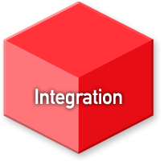
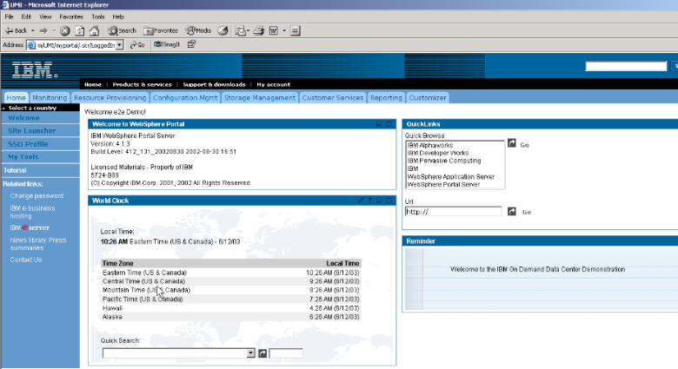
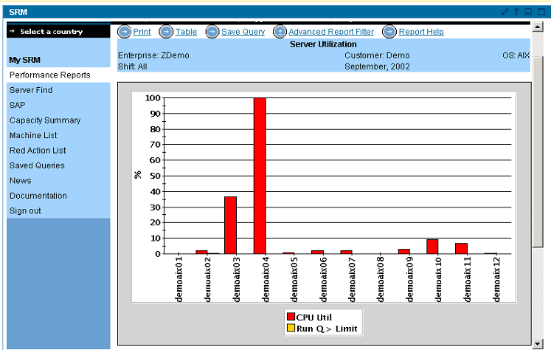
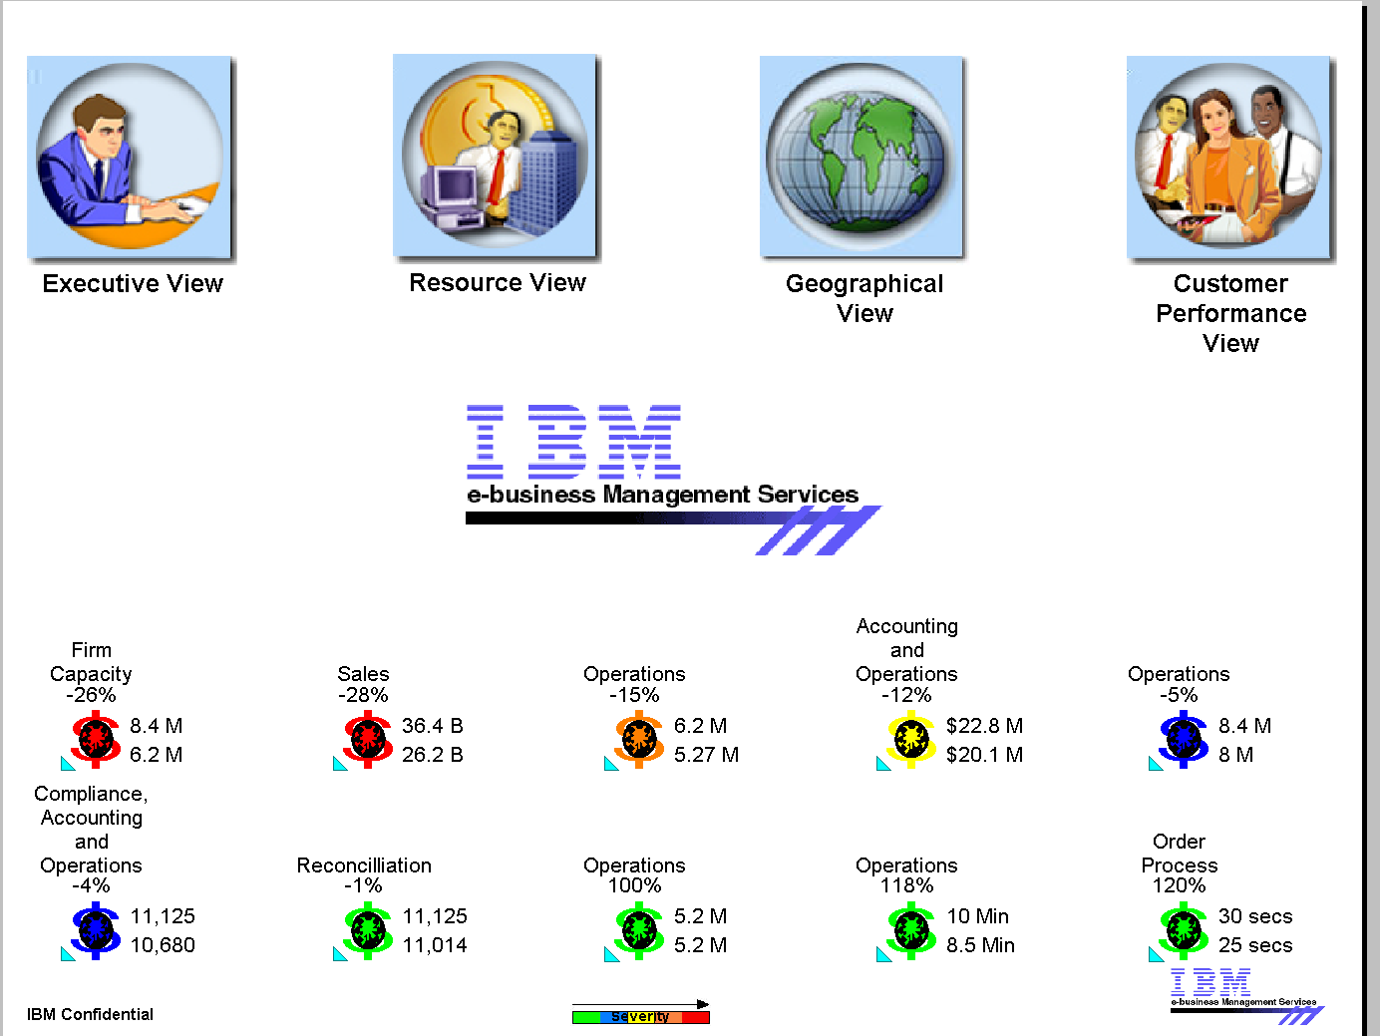
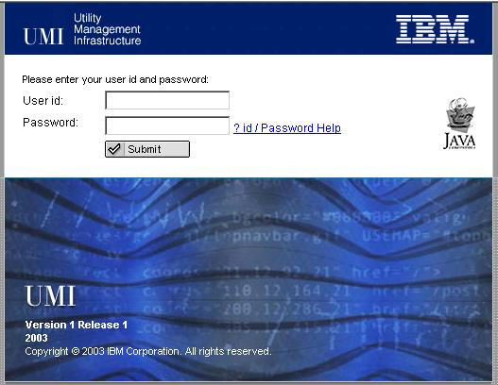
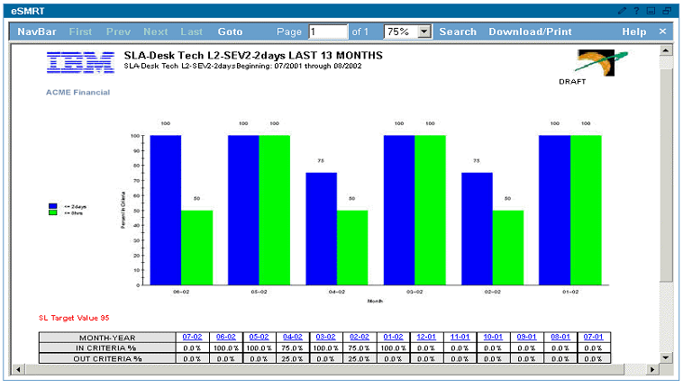
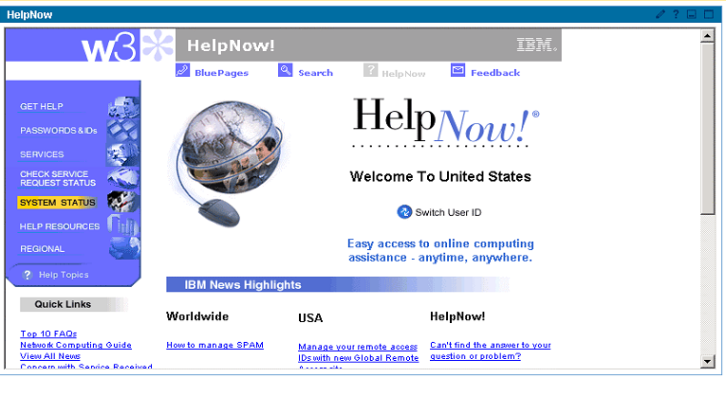
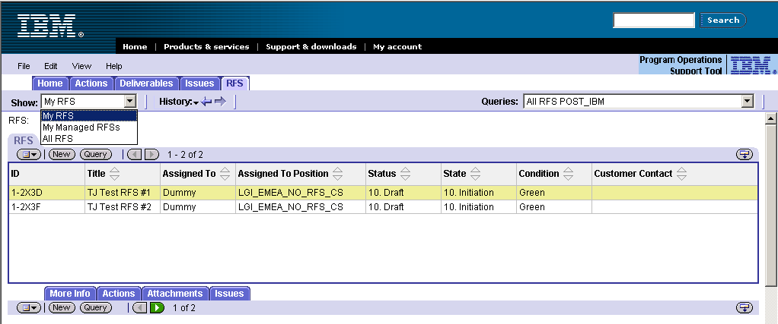
Visualization empowers customers, links people by exploiting technology
UMI visualization provides a customer facing web portal to monitor Enterprise Operational Processes and Program Management Processes
…
EOPs
Provi-sioning
Performance Mgmt
Availability Mgmt
Asset
Mgmt
Problem/ Change
Request for Service
Program Issues Mgmt
Customer Satisfaction Mgmt
Customer Comm. Mgmt
…
PMP
Enterprise Operational Processes
Program Management Processes

Slide 6
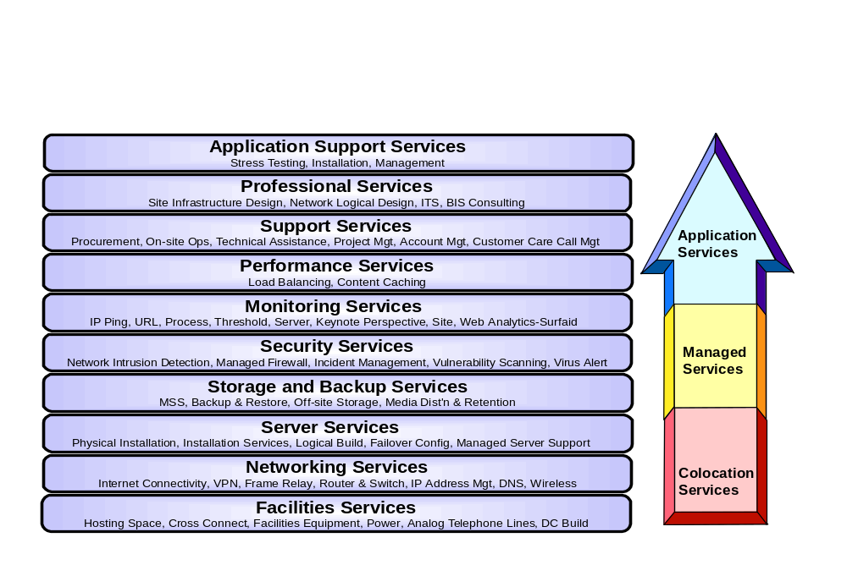
Broad Continuum of Flexible Delivery Services

Slide 7
Virtual Hosting Services - More control or lower costs
In-House Computing
Traditional Managed Hosting
Virtual Hosting Services
IT Infrastructure
Dedicated, any IBM/vendor mix
Dedicated, limited IBM/vendor mix
Virtual, IBM-selected environment
Applications
Dedicated, any IBM/vendor mix
Dedicated, any IBM/vendor mix
Dedicated, supported operating systems
Management/ control
Customer
IBM-managed, optional customer management
IBM-managed
Gap Solution
Capacity design point
Peak usage
Peak usage
Planned usage with capacity on demand
Scalability
Typically low
Moderate
High
Low-to-moderate
Capital investment
Large-scale, up-front investments
Incremental investments
No capital investment
Cost profile
Asset-based fixed costs
Up-front implementation charge plus monthly fixed rate
Nominal up-front setup charge plus usage-based monthly charges
Cost savings v. in-house
NA
10-20%
15-25%

Slide 8





Starting in Boulder, the Gap Can Leverage UMI Services
Virtual server hosting services
Internet
Dedicated server hosting services
Customer A
Dedicated hosting environment
Customer X
virtual xSeries
Customer B
Customer C
Dedicated
Infrastructure
and
Management
Services
Customer D
Virtual Networking Services
Dedicated hosting environment
Customer Y
virtual zSeries
Customer E
Customer F
Customer G
Universal Management Infrastructure
IBM Management Toolset
Dedicated hosting environment
Customer Z
virtual pSeries
Customer H
Customer I
Boulder Delivery Center
End-to-end utility solution
End-to-end dedicated environment
Blended environment of virtual and dedicated servers and services
Notes:
IBM has designed a DC → ODCS
IBM has leveraged an ESM approach to UMI and providing flexibility.

Slide 9


Traditional hosting compared to flexible hosting services
Flexible Hosting Services
Traditional Hosting
Boulder Delivery Center
Firewall & Load Balancer
Networking Services
Web Servers
Secure Sign On
User Registration
Application & Transaction Servers
Switches
…
Common Services
Server Services
Storage Services
Storage, B&R, DB Servers
Switch Fabric
Monitoring & Management
Utility Management Infrastructure
Customers choose degree of control and management to retain over servers and infrastructure
Provider chooses standards for infrastructure services & manages the virtualized environment
Key:
Management & Operations Labor
Hardware Utilization Level
Notes:
DC consolidation
SW and Infra Virtualization
Billing – pay for use.
Competitive advantage through workflow standards…enables increased productivity to leverage new technologies/applications.

Slide 10
Capacity That More Closely Matches Your Demand
“Unmet” capacity need
“Unused” capacity
160
Capacity, which is
160
140
increased and paid for in
“Unused”
140
120
a step
-
function manner
capacity
120
100
100
80
80
Capacity
60
Capacity
60
40
“Used” capacity
40
“Used” capacity
20
20
0
0
T0
T1
T2
T3
T4
T5
T6
T7
T8
T0
T1
T2
T3
T4
T5
T6
T7
T8
“Lost” capacity from initial
Time period
“Lost” capacity from initial
Time period
setup and testing period
setup and testing period
Current IT pricing mechanism
Usage
-
based pricing mechanism

Slide 11
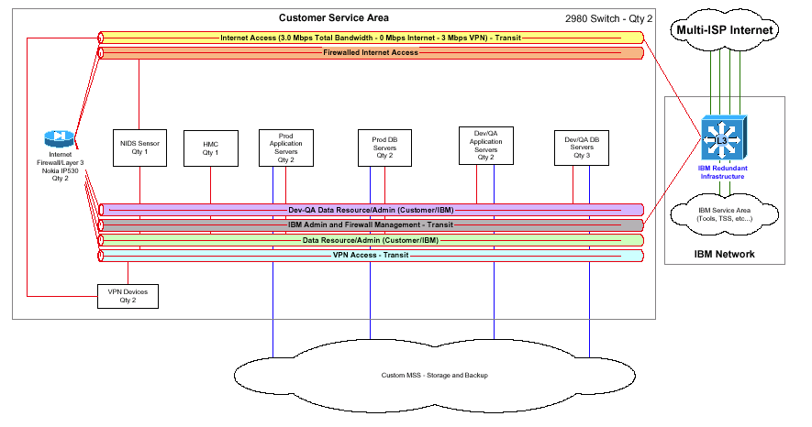
GAP Solution Overview

Slide 12
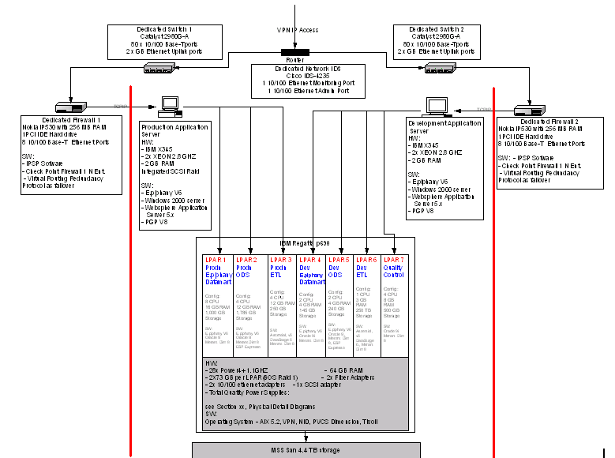
Proposed Physical Architecture

Slide 13
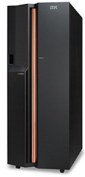
Hardware Configurations
pSeries Regatta 690 (QTY = 1) | 7 x LPAR 28 x Power4+ 1.1GHZ (32 CUOD) 64 GB RAM 14 x 73 GB (2 per LPAR) (BOS Raid 1) 14 x Fibre Adapters (2 per LPAR) 14 x 10/100 ethernet adapters (2 per LPAR) 7 x SCSI adapter (1 per LPAR)
LPAR Breakdown (CPU & Memory) | LPAR 1: 8 x 16 Production E.piphany Mart LPAR 2: 4 x 12 Production ODS DB LPAR 3: 4 x 12 Production ETL Application LPAR 4: 2 x 4 Development E.piphany Mart LPAR 5: 2 x 4 Development ODS DB LPAR 6: 1 x 3 Development ETL Application LPAR 7: 4 x 8 QA Application / DB
xSeries (QTY=2) | 2 x XEON 2.8GHZ 2 GB RAM Integrated SCSI Raid 2 x 73 GB (BOS Raid 1) 2 x Fibre Adapters 2 x 10/100 ethernet adapters
pSeries Console | 32 bit Intel Desktop DVD RAM Drive 2 x Asynch Ports 1 x 10/100 port 2 x 15 m Host Attach Cables

Slide 14
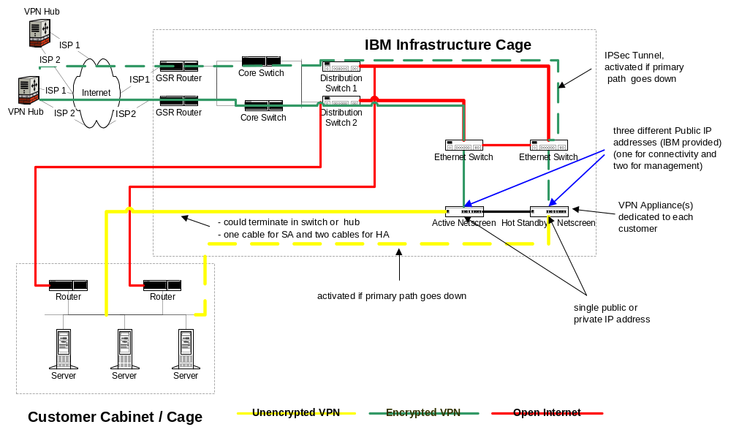
High Availability VPN configuration

Slide 15

Storage Configurations
FAStT 700 Storage Server | 84 x 73.4 GB/15K Disk Modules 2 x FAStT 2 Gbps Mini Hubs 18 x short wave SFP
IBM Ultrascalable Tape Library 3584-L32 | 12 x LTO Ultrium 2 Fibre Drive 20 x Additional LTO I/O Slots 1 x Controll Path Failover 1 x Fibre Channel patch Panel
TSM Server | IBM pSeries 630 2 x 2-WAY 1.45GHZ PWR4+ 2 x 2048MB DIMMS 2 x 36.4 GB 10K RPM U3 SCSI DDA 2 x 146.8GB 10K RPM U3 SCSI DDRASS 2 x 2 GIGAB FIBRE CHANN PCI-X ADPT 1 x 4 Port 10/100 Ethernet

Slide 16
Software
IBM Provided | The Gap Provided
AIX 5.2 Operating System Windows 2000 Server Operating System Tivoli Storage Manager Tivoli Data Protection Merant Dimensions v8 Ascential DataStage Enterprise Edition PGP v8 BMC Patrol Server Resource Manager | Trillium Oracle 9i E.piphany Mercury WebSphere Business Integration Server ESP Espresso

Slide 17

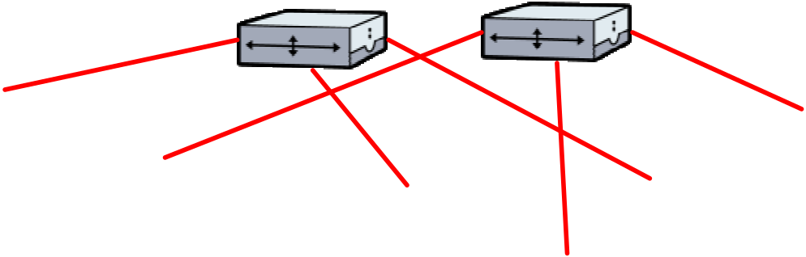
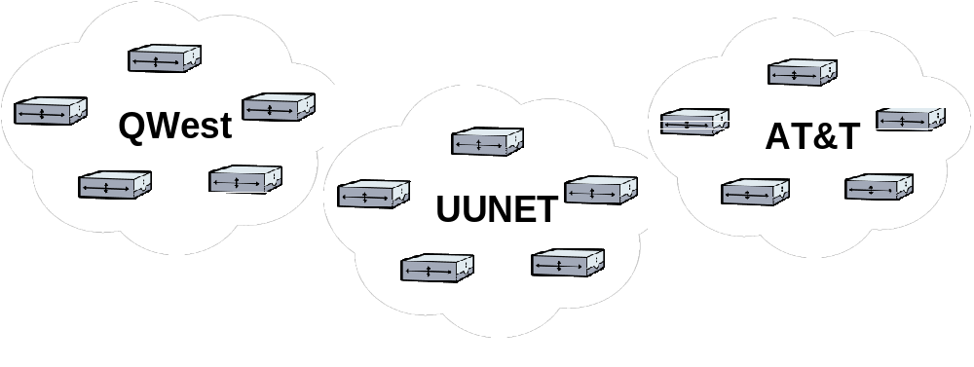
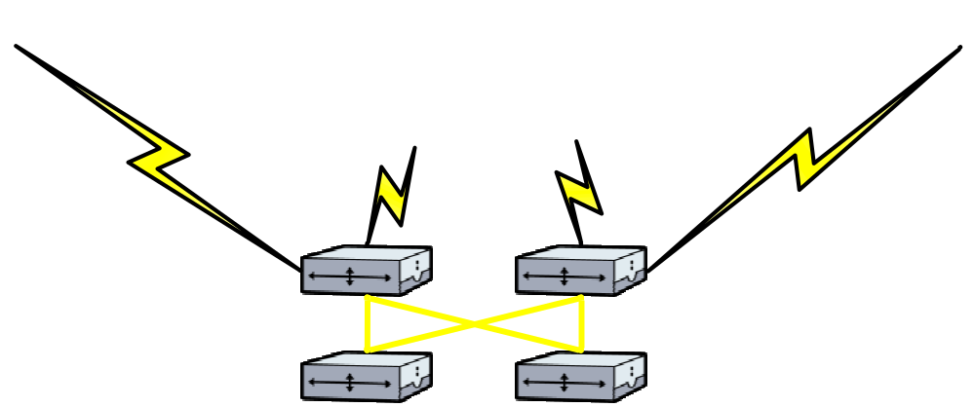
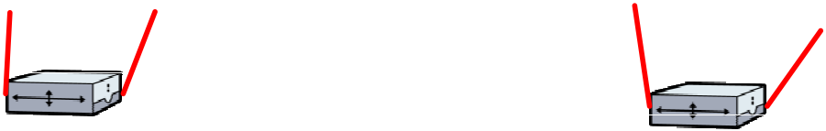
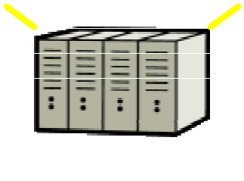
Multiple-ISP Architecture
Components
Up to OC 192 Capacity (with Gig E handoff to Customer)
Self-healing SONET rings with diverse routes and POPs
Multiple Internet Service Providers
Diverse connection points into IBM
Advantages
High Availability
Performance
Service Levels

Slide 18
Management Tools
  Tivoli/BMC - Framework for Event Console - rulebase event handler/collator
  NetView/MLM - SNMP poller/receiver, Device availability (ping)
  PCPMM - Port Connect Pattern Matching Monitoring - URL poller
  Syslog - System logger function for server/network devices
  SRM - Server Resource Management - Collects data 24x7
  Database, server, FTPs logs and create web reports
  NodeWatch Notify - Emails alerts from TEC to customer

Slide 19
Security Services
Included in Proposal:
  Anti-Virus Services
  Network-based Intrusion Detection
  TCP/IP Vulnerability Scanning
Other Available Services:
  Security Advisory Services
  Host-based Intrusion Detection
  Security Validation and Compliance Checking
  Vulnerability Assessment Testing
  Incident Management
  Information Security Advisor (ISA)
  Issue Tracking

Slide 20
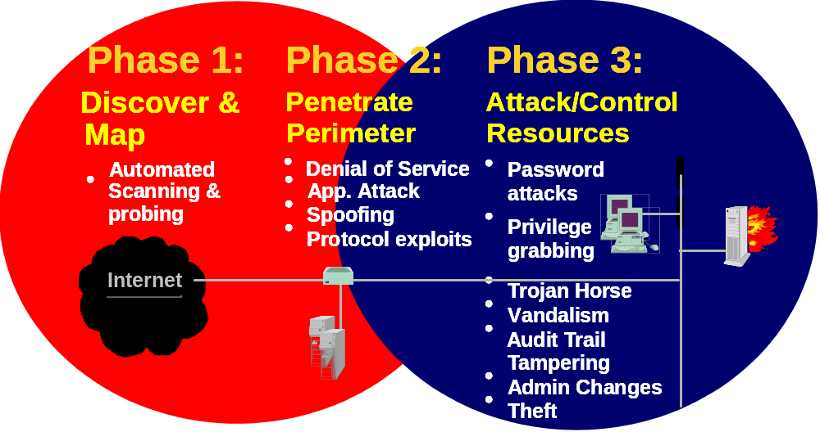
Network-Based Intrusion Detection
Centrally monitors network security in real time,
24x7x365, allowing IBM to detect and respond to network intrusions while they are happening.

Slide 21
Security Tools
Documented security policies
Norton Anti-Virus
APAR / CERT Advisories
ASERT
Cisco Secure IDS
NSAFE
  Network Services Auditor
  Enterprise Security Manager
CIRATS
Notes:
APAR / CERT Certs Advisories = cert.org carnagie mellon, cert coordination center,
IBM subscribes to cert and we submit, we get certs advisorys, then turn into apars.
ASERT = collects information, listens port telnet, talk failed login, logs service, Denial of service, host detection.
NSAFE = ibm developed sdc west, symantec enterprise security mgr internal
NSA = scan externalary,
CIRATS = sdc west thing, document the vulenbility, and internal tool for policy and procedures. Audits of service delivery.
SAS 70 compliance. Checks and balance.

Slide 22
TCP/IP Port Vulnerability Scanning
Network Service Auditor (NSA)
IBM research developed tool managed by Managed Security Services
Weekly port scan testing for known vulnerabilities
Internal and External Scan
Scan from Internet
Scan from trusted network
Broad range of ports
Vulnerabilities categorized and graded
Detailed reports
Results are managed by a Security Review Team

Slide 23
e-business Security Policy
Standard USF Security Policies and Practices
Ensures everyone understands the scope of their security responsibilities
Ensures IBM support teams know how systems are to be securely set up and maintained
Ensures that the required security processes are known

Slide 24
Infrastructure Support Services
Managed Server Support
  OS Systems Administration and Real-Time Monitoring of all LPAR instances and servers
  Ping Monitoring
  Virus Protection
  Process Monitoring
  Threshold Monitoring
  Database Monitoring
  Server Resource Monitoring for Historical Performance/Capacity Planning
Network Connectivity
  Managed High Availability VPN
  Committed Information Rate of 3 Mbps with redundant 10Mbp internet connection
  Managed High Availability Cisco Switches
  Managed Network Intrusion Detection Services
Managed Storage Services
  Back up and Restore services using Tivoli Storage Manager
Acceptance Testing Support for Infrastructure
Transaction Availability Monitoring – End to End Script Running/Maintenance

Slide 25
Transition Activities
Implementation Milestones for eBHS Environment
  Confirm Infrastructure Design (Due Diligence)
  Prepare and Install Physical Environment
  Install Phase 1 (QA / Development Environments)
    Order and receive hardware
    Network Switch Build
    Firewall Implementation
  Physical / logical build
    Sys Admin Setup
    Middleware Load
  Install Phase 2 (Production)
  Order and receive hardware
  Physical / logical build
  Sys Admin Setup
    Middleware Load

Slide 26
Service Levels
Transaction Availability E2E → 99.5%
Network Availability → 99.99%
Network Latency → < 60 ms
Average Packet Loss → < .5%
Others TBD

Slide 27
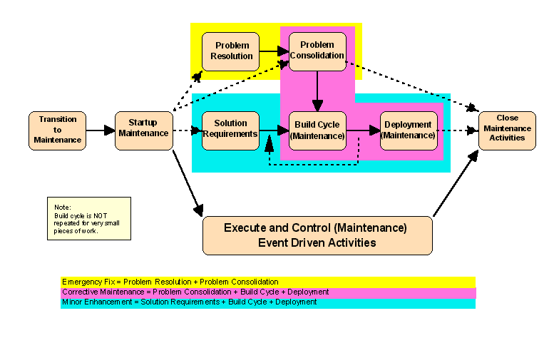
The IBM Application Management Services team will provide on-going Application Support, Maintenance and Small Enhancements.

Slide 28
The IBM support team will participate in implementation - which will minimize transition time and reduce knowledge transfer activities.
June
July
Aug
Sep
Oct
Nov
Dec
2005
2006
Transition Planning
Transition Kick-off
Transition to Support
Develop Communications Plan
Configure Off-site Connectivity
Document Application Support Plan
Document Support Procedures
Determine Measurement Systems
Build Baselines and Controls
Implement Support Tools
Migrate Application Support Responsibilities
Cutover to Steady State concurrent with Go Live
Steady State Support
Project Management
Maintenance
Small Enhancements
Testing
Deployment and Release Management
Problem Management
Service Request Management
Application Change Management

Slide 29
Our steady state model provides for clear lines of communication with well defined roles and responsibilities for project delivery.
Communication
Strategic Direction
End-user Interface
Program Management
Requirements Specification
User Acceptance Testing
Governance
GAP
LOCAL IBM TEAM
1 Technical Manager
Primary Client Interface
Project Management
Business Direction
Subject Matter Expert
Requirements Analysis
Planning & Estimating
External/High Level Design
Integration Testing, Acceptance Testing Support
Defect support
Communication
INDIA
IBM TEAM
3 Technical Resources (ETL, E.piphany, Oracle)
Internal/Low Level Design
Programming & Unit Testing
Production Support
Defect support
Process
Methods
Tools
Consistent Practices, Subject Matter Expertise, Lessons Learned
This structure gives GAP the convenience of having local points of contact, while still enjoying the cost advantages of offshore resources.

Slide 30
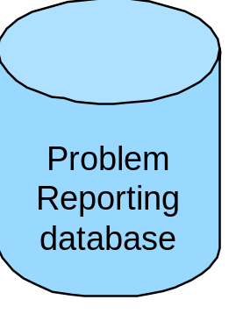
IBM will work with GAP to integrate Level 2 and Level 3 Application Support into the overall GAP Call Center/Help Desk process.
Support Structure
Level 1
Level 2
Level 3
IBM
Onsite/
Offsite Team
IBM
Onsite/
Offsite Team
GAP
Help
Desk
User related problem resolution
Problem Analysis,
Problem resolution
as appropriate,
Severity Level
Assignments in
conjunction with
SPE
Problem
Resolution

Slide 31
Helpdesk and Escalation Support
Help Desk Services
  IBM provides 24x7 Level 2 Help Desk for Application and Hosting Services
  Receive Calls from Gap’s end user Help Desk
  Problem Determination / Resolution / Tracking
  e-business Hosting Connection Portal
  Route e-Piphany application questions to application experts
  Resolve alerts automatically generated by the IBM Monitoring Tools
Escalation Support
  Raising the awareness level of an open issue to a higher level of management or technical area.
Severity | First Response | Update Frequency for Continuing Problems
1—Critical | Within 30 minutes | 2 hours
2—Major | Within 2 hours | 12 hours
3—Minor | Within 1 day | 24 hours
4—Low Impact | Within 2 days | 7 days

Slide 32
IBM e-business Hosting Connection
http://www.ibm.com/services/myhosting
Visibility to IBM e-business Hosting environment through a personalized/secure Web-based interface
Access to IBM HelpNow! Ticket/Request creation and status
View billing information
Access reports (e.g., Server Resource Manager, Performance, Monitoring Status, etc.)
Receive news and information on IBM's service offerings

Slide 33
IBM’s Problem Management Approach is focused on a close looped problem management process to insure root cause identification and problem prevention.
New Ticket
Problem
Enhancement
Yes
Estimate
Created
Analyzed
Yes
SLA
NO
GAP and / or IBM
GAP
Technical
PM
Solution
Yes
Close
Ticket
Found in KB
Closed
GAP
No
Assign to a
No
Queue
Application
Team
Developer
Assign to a
Yes
Yes
Transition
Specific
Report
Person
Application
Developer
Severity 1
NO
Resolved
Solution
Defect?
No
EOD?
Implementation
Application
Developer
YES
Yes
NO

Slide 34
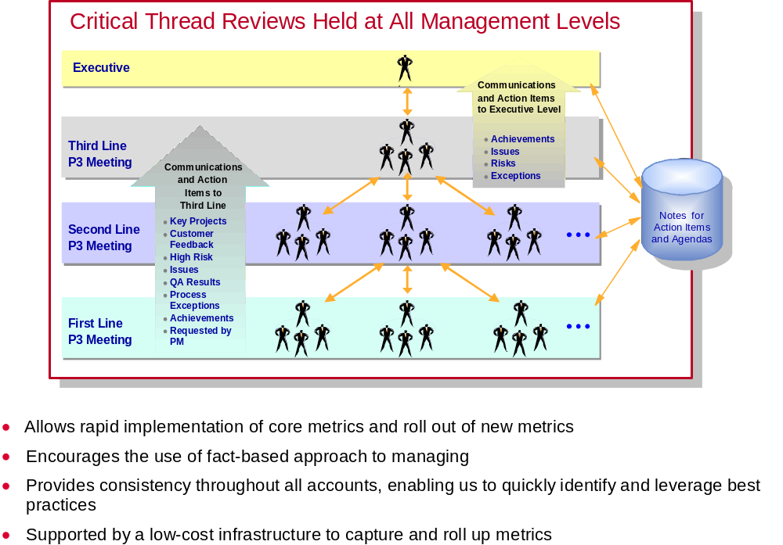
IBM’s Metrics Management Framework re-enforces the appropriate practices for management within the organization

Slide 35
IBM will tie on-going reporting to performance
Scorecard
Financial
Customer/Client
Development
Innovation
Measures
/User Measures
Process
and Growth
On Budget Delivery/
Client Satisfaction Survey
Work Output Productivity
Maturity
Project Estimation
Assessment (SEI/CMM)
Cycle Time /
On Time Delivery/
Customer Satisfaction
Incident Handling
Process Compliance
Project Estimation
Survey
Defect Rate / Adherence
to Specifications
Service Requests
Milestone Completion

Slide 36
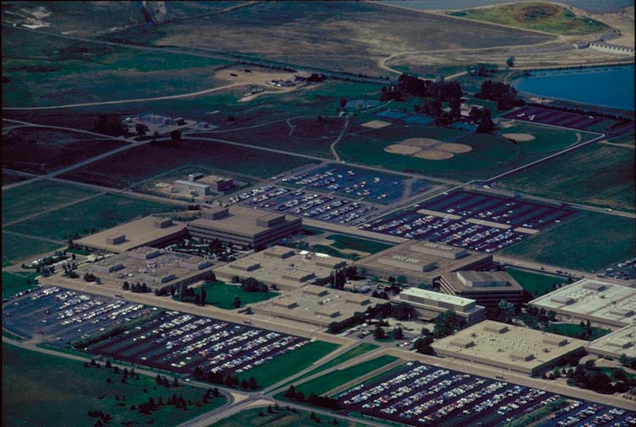
IBM Boulder Service Delivery On Demand Center
Command Center and NOC
Helpdesk
BCRS Recovery Center
Data Center

